Slide 1
Computational Complexity
计算复杂性
Lecture 13 One-way function

Slide 2
One-way function
One-way function
Hard-core predicates
Examples of One-way functions
Pseudorandom generators
Probabilistic Encryption schemes

Slide 3
单向函数
Loosely speaking, one-way functions are functions that are easy to evalute but hard(on the average) to invert.
That is, a function f:{0,1}*→{0,1}* is called one-way if there is an efficient algorithm that on input x output f(x), whereas any feasible algorithm that tries to find a preimage of f(x) under f may succeed only with negligible probability.

Slide 4
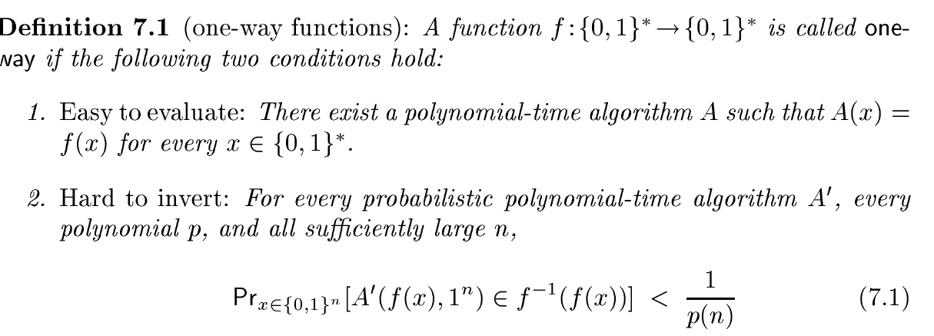
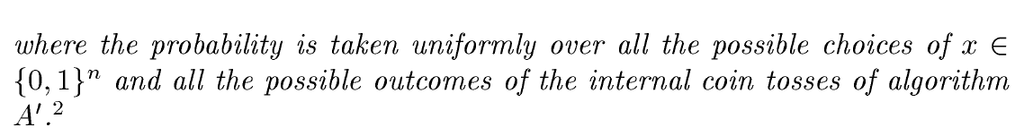
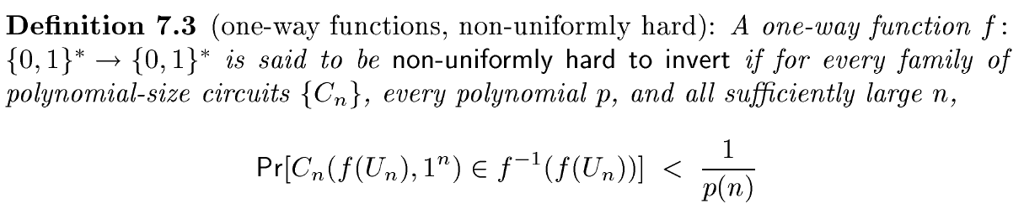

Slide 5
Do one-way functions exist?
The existence of such one-way functions is still an open conjecture. In fact, their existence would prove that the complexity classes P and NP are not equal, thus resolving the foremost unsolved question of theoretical computer science.
Existence of a proof that P and NP are not equal would not directly imply the existence of one-way functions.
P != NP is not known to imply the existence of languages in NP which are hard on the average.

Slide 6
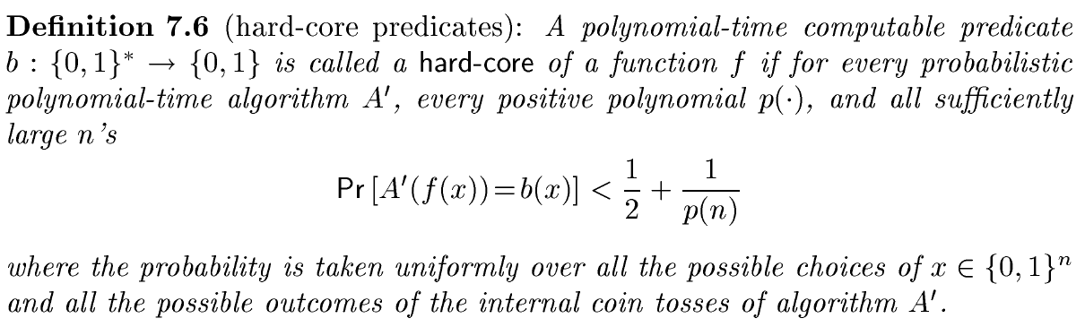
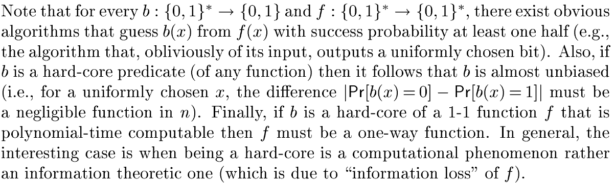
Hard-core predicates

Slide 7
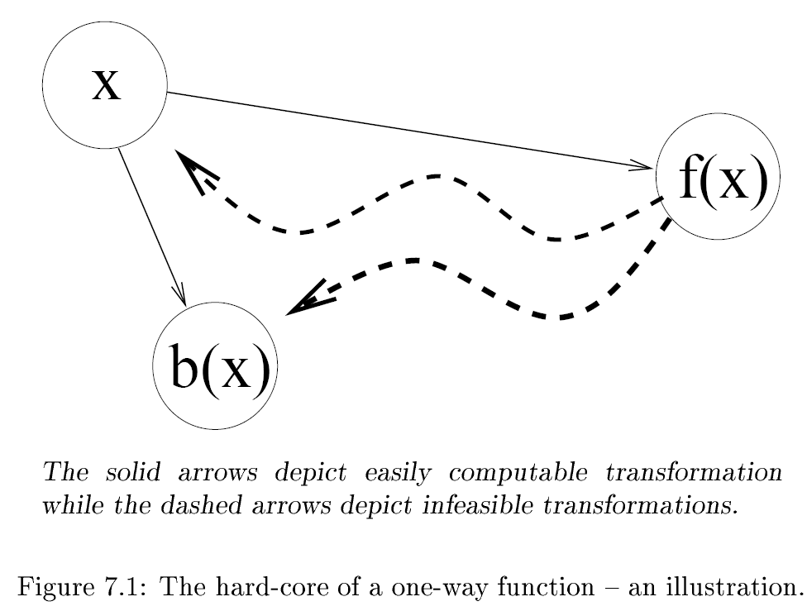

Slide 8
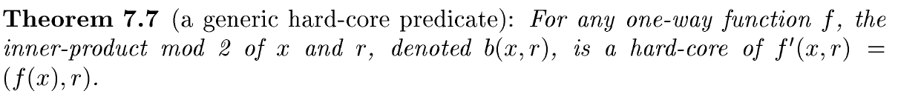
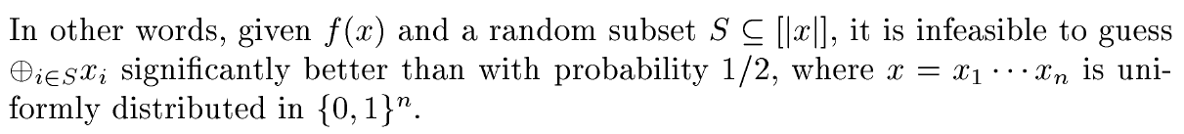
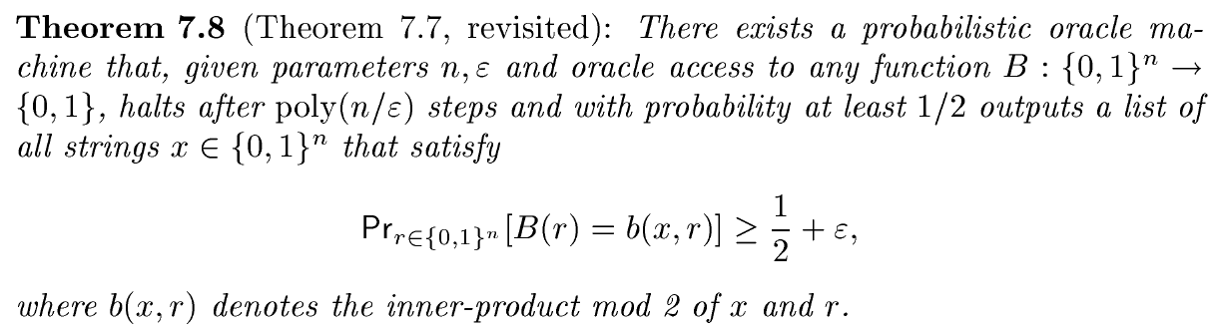

Slide 9
Hard-core predicates应用
Genreal-purpose pseudorandom generators
Commitment schemes
Zero-knowledge proofs
Encryption schemes

Slide 10
Examples of One-way functions
Examples of hard problems:
Subset sum
Discrete log
Factoring numbers into prime components

Slide 11
Subset Sum
Subset sum problem: given
  n numbers 0 ≤ a₁, a₂ ,…, a_{n} ≤ 2^{m}
  Target sum T
  Find subset S⊆ {1,...,n} ∑ _{i ∈S} a_{i},=T
(n,m)-subset sum assumption: for uniformly chosen
  a₁, a₂ ,…, a_{n} ∈_{R}{0,…2^{m -}1} and S⊆ {1,...,n}
  For any probabilistic polynomial time algorithm, the probability of finding S’⊆ {1,...,n} such that
  ∑ _{i ∈S} a_{i}= ∑ _{i ∈S’} a_{i}
  is negligible, where the probability is over the random choice of the a_{i}‘s, S and the inner coin flips of the algorithm
  Not true for very small or very large m
Subset sum one-way function f:{0,1}^{mn+n} → {0,1}^{mn+m}
f(a₁, a₂ ,…, a_{n} , b₁, b₂ ,…, b_{n} ) =
(a₁, a₂ ,…, a_{n} , ∑ _{i=1}^{n} b_{i} a_{i} mod 2^{m} )
Assumption ⇒ f is one way

Slide 12
Discrete Log Problem
Let G be a group and g an element in G.
Let y=g^{z} and x the minimal non negative
integer satisfying the equation.
x is called the discrete log of y to base g.
Example: y=g^{x} mod p in the multiplicative group of Z_{p}
In general: easy to exponentiate via repeated squaring
  Consider binary representation
What about discrete log?
  If difficult, f(g,x) = (g, g^{x} ) is a one-way function

Slide 13
Integer Factoring
Consider f(x,y) = x • y
Easy to compute
Is it one-way?
  No: if f(x,y) is even can set inverse as (f(x,y)/2,2)
If factoring a number into prime factors is hard:
  Specifically given N= P • Q , the product of two random large (n-bit) primes, it is hard to factor
  Then somewhat hard – there are a non-negligible fraction of such numbers ~ 1/n² from the density of primes
  Hence a weak one-way function
Alternatively:
  let g(r) be a function mapping random bits into random primes.
  The function f(r₁,r₂) = g(r₁) • g(r₂) is one-way

Slide 14
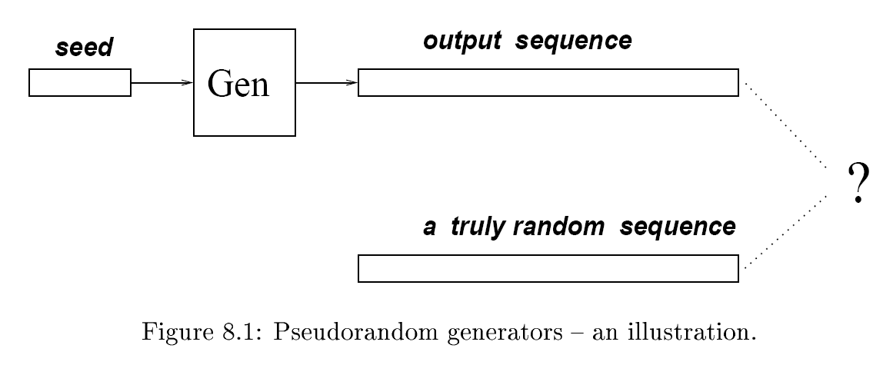
PSRG

Slide 15
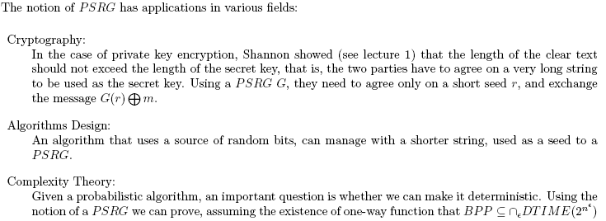

Slide 16
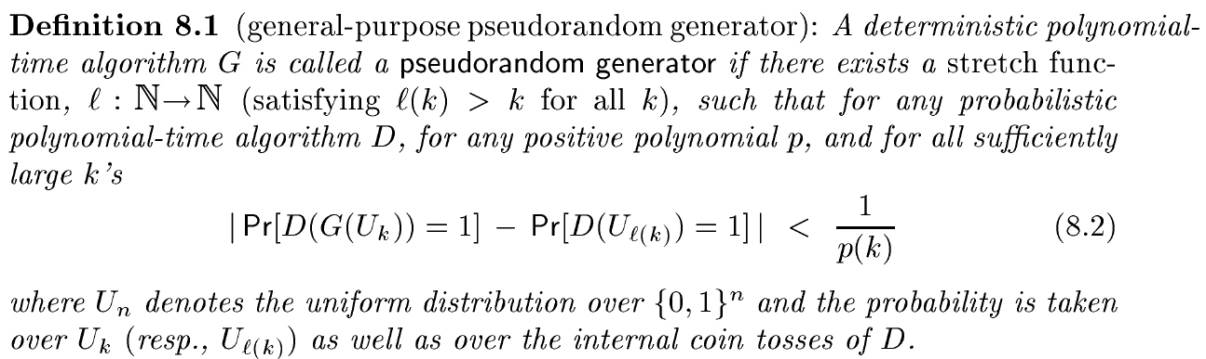

Slide 17
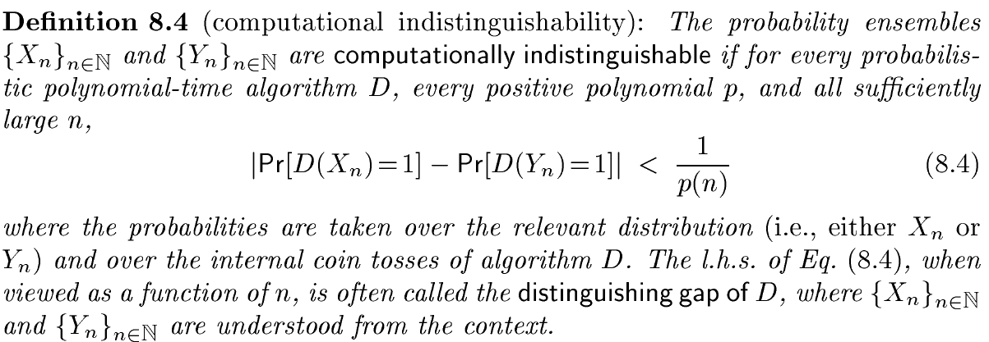

Slide 18
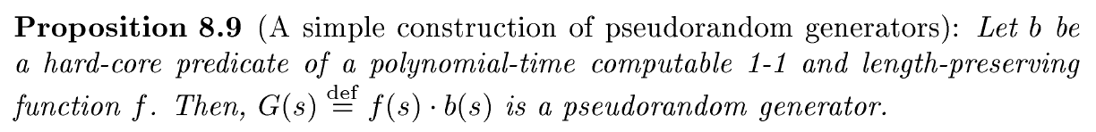
证明：
  8.9假设存在D算法可区分G(s)与均匀分布，则存在算法A，可以预测b(s)
  8.11构造f(x,y)=G(x)

Slide 19
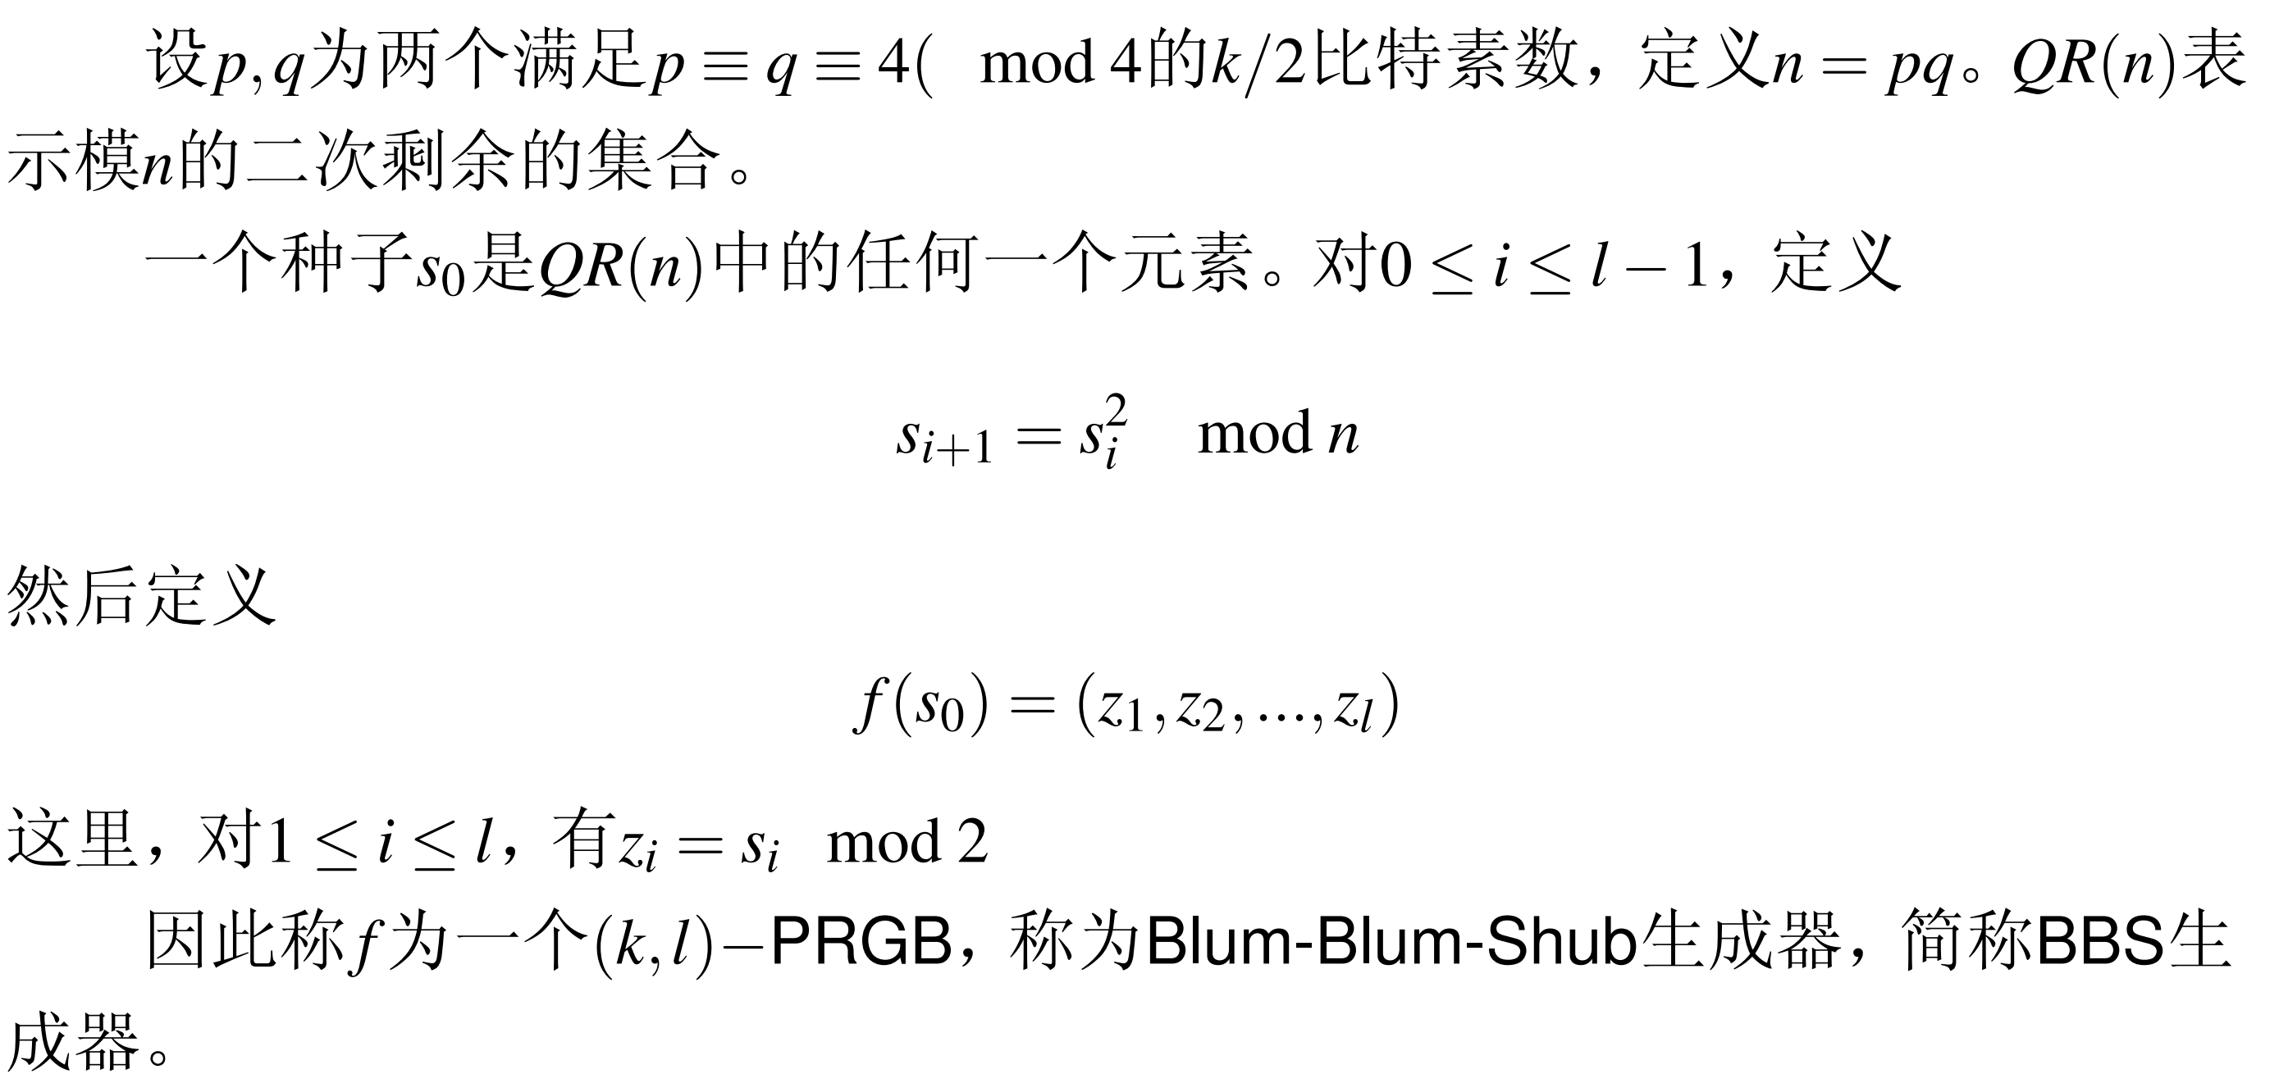
Blum-Blum-Shub生成器

Slide 20
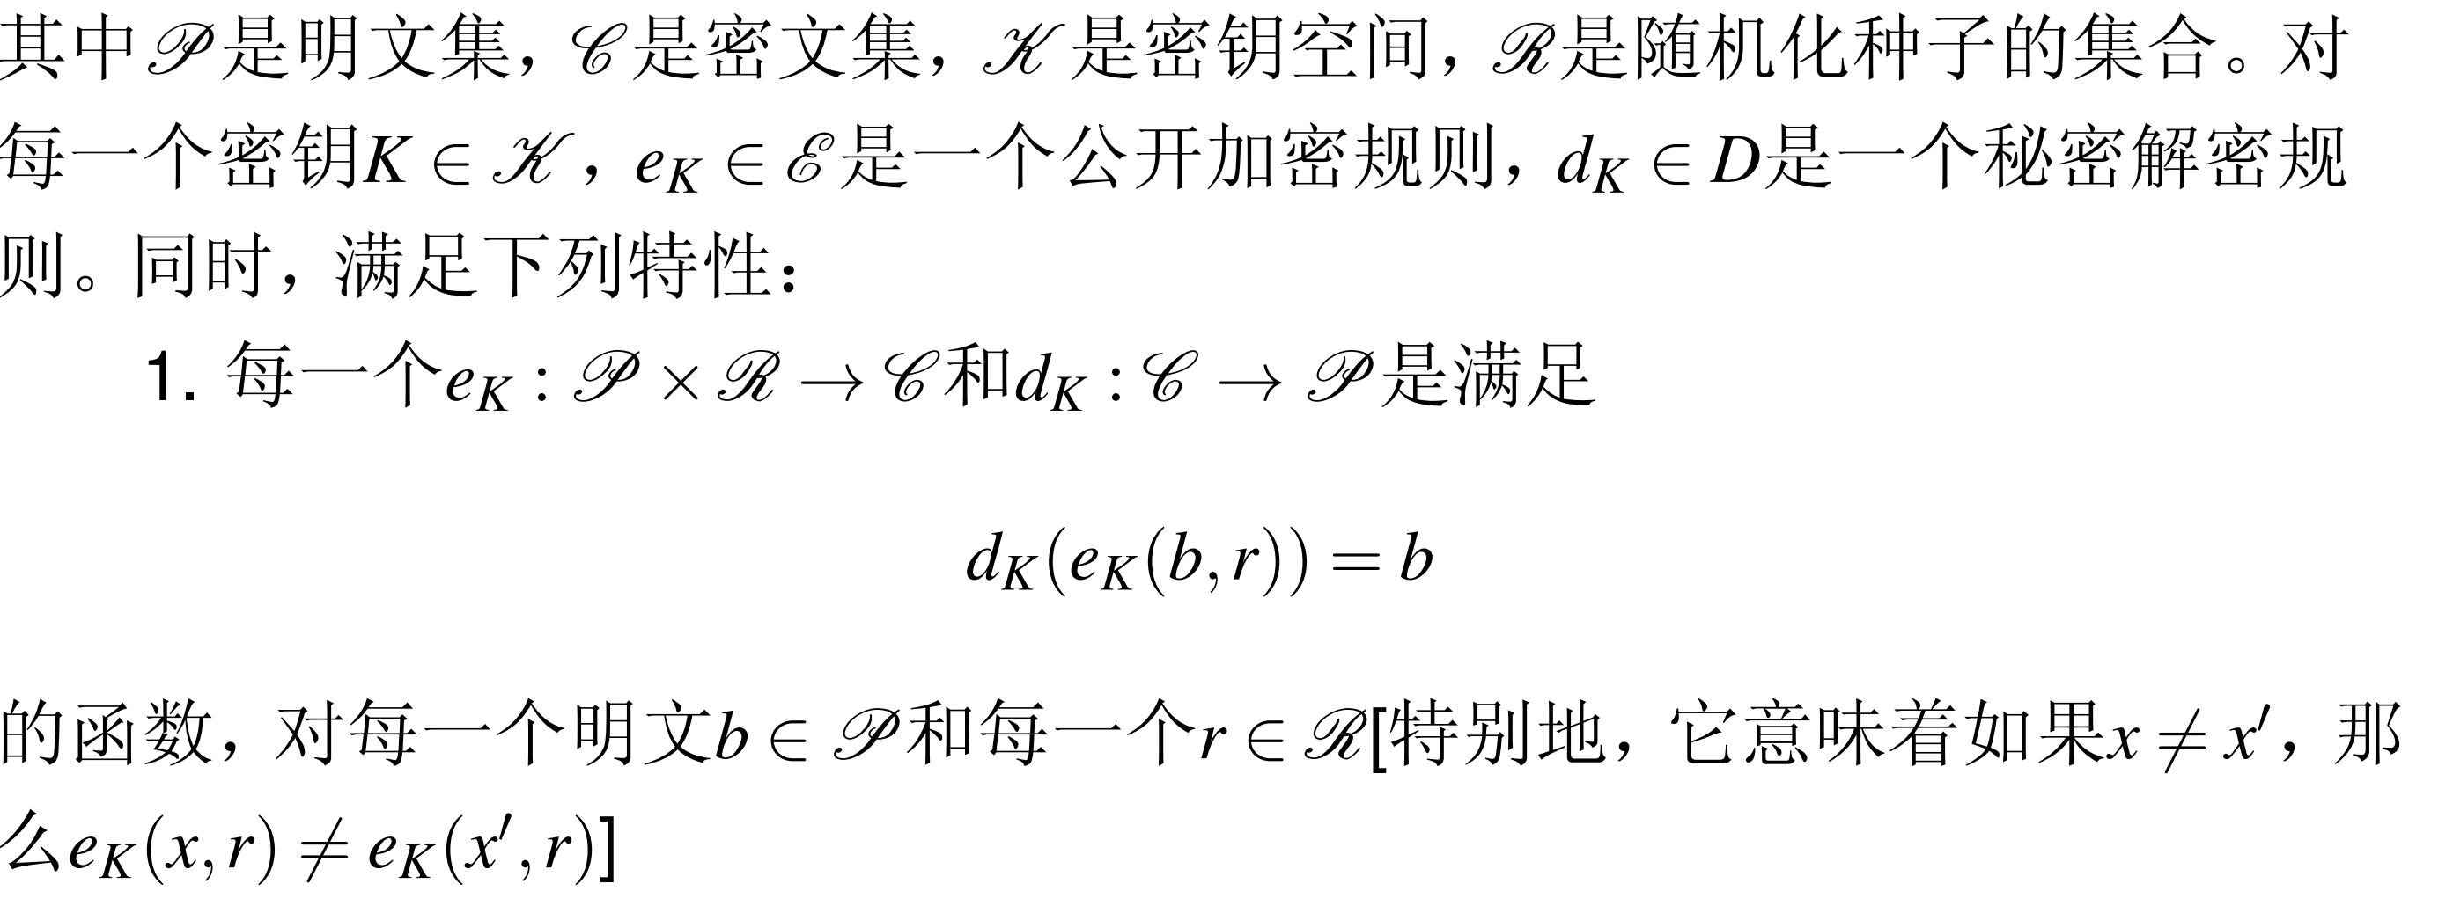
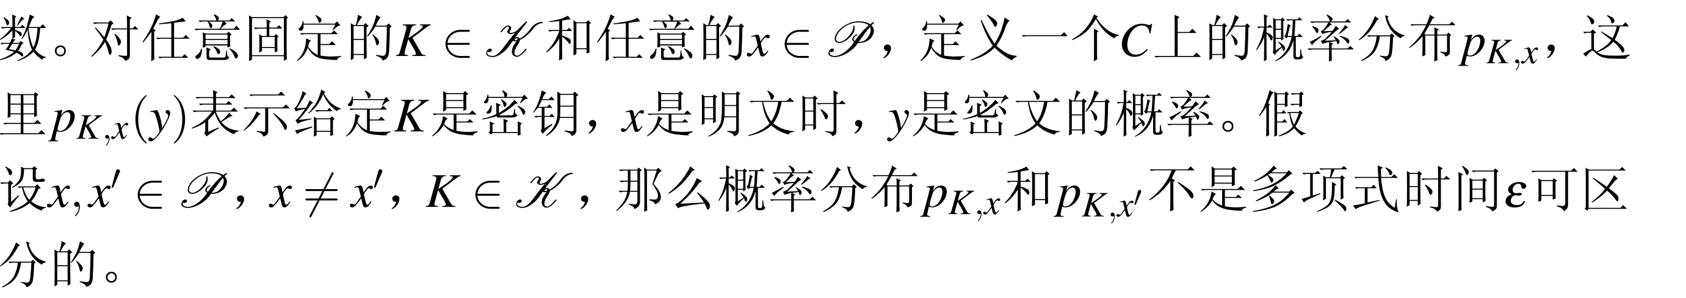
概率加密

Slide 21
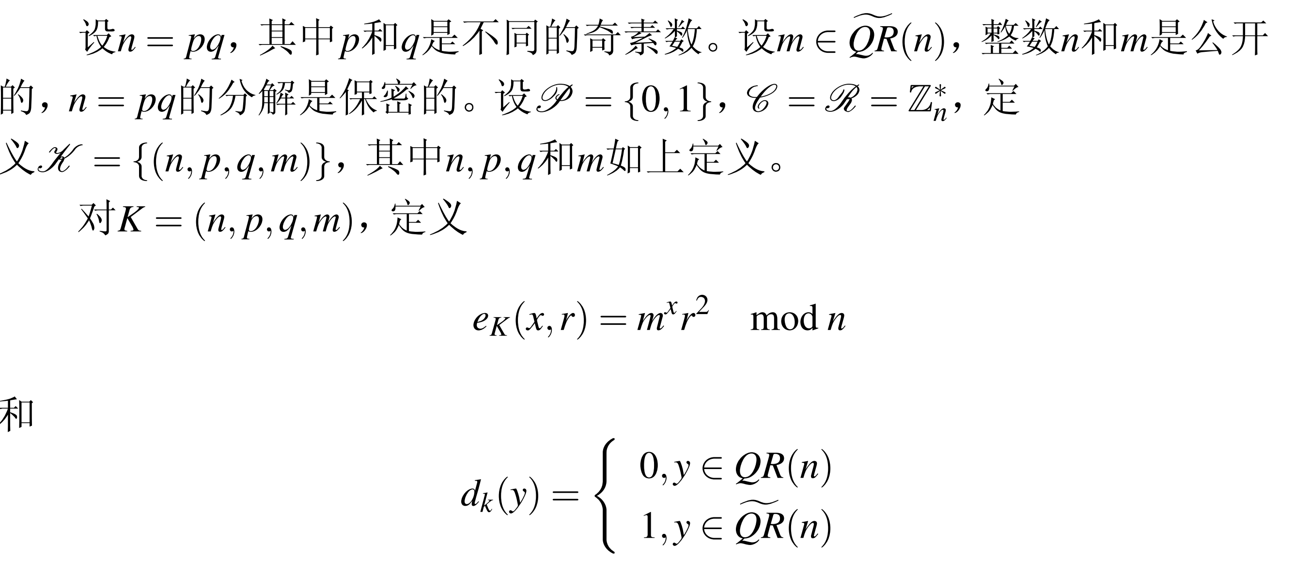
Goldwasser-Micali公钥加密体制

